Slide 1
Hotel Booking Analysis
Project Type: EDA
Submitted By: Dipangi Jadav

Slide 2
Project Summary
For this project we will be analyzing Hotel Booking data. This data set contains booking information for a city hotel and a resort hotel and includes information such as when the booking was made, length of stay, the number of adults, children, and/or babies, and the number of available parking spaces.
Hotel industry is a very volatile industry, and the bookings depends on above factors and many more.
The main objective behind this project is to explore and analyze data to discover important factors that govern the bookings and give insights to hotel management ,which can perform various campaigns to boost the business and performance.
The analysis will focus on identifying patterns in bookings and cancellations, customer demographics and preferences, and the effectiveness of different distribution channels.

Slide 3
Business Objective
To gain a comprehensive understanding of booking patterns and customer behavior.
Understand which amenities and services are most popular among guests.
Determine key drivers of occupancy, revenue, and customer satisfaction.
Form strategies for increasing occupancy, revenue and customer satisfaction.

Slide 4
Data Collection and Understanding
Data Source: Hotel Booking | Kaggle
This dataset contains 119390 observations and 32 columns for a City Hotel and a Resort Hotel. Each observation represents a hotel booking between the 1st of July 2015 and 31st of August 2017, including booking that effectively arrived and booking that were canceled.
Columns have data type object, int64, and float64.
There are 4 columns company, country, agent and children with missing values.
Data had 31994 duplicate values, so we removed it.
Libraries used are Pandas for Data Manipulation and aggregation. Matplotlib and Seaborn are for Visualization and NumPy is for computational effective operations.

Slide 5
Data Description
hotel :Resort Hotel or City Hotel
is_canceled : Value indicating if the booking was canceled (1) or not (0)
lead_time : Number of days that elapsed between the entering date of the booking and the arrival date
arrival_date_year : Year of arrival date
arrival_date_month : Month of arrival date
arrival_date_week_number : Week number of year for arrival date
arrival_date_day_of_month : Day of arrival date
stays_in_weekend_nights : Number of weekend nights
stays_in_week_nights : Number of weeknights.
adults : Number of adults
children : Number of children
babies : Number of babies
meal : Type of meal booked.
country : Country of origin.
market_segment : Market segment designation. (TA/TO)
distribution_channel : Booking distribution channel.(T/A/TO)
is_repeated_guest : is a repeated guest (1) or not (0)

Slide 6
Data Description
Previous_cancellations : Number of previous bookings that were cancelled by the customer prior to the current booking
previous_bookings_not_canceled : Number of previous bookings not cancelled by the customer prior to the current booking
reserved_room_type : Code of room type reserved.
assigned_room_type : Code for the type of room assigned to the booking.
booking_changes : Number of changes made to the booking from the moment the booking was entered on the
PMS until the moment of check-in or cancellation
deposit_type : No Deposit, Non-Refund , Refundable.
agent : ID of the travel agency that made the booking
company : ID of the company/entity that made the booking .
days_in_waiting_list : Number of days the booking was in the waiting list before it was confirmed to the customer
customer_type : type of customer. Contract, Group, Transient, Transient party.
adr : Average Daily Rate as defined by dividing the sum of all lodging transactions by the total number of staying nights
required_car_parking_spaces : Number of car parking spaces required by the customer
total_of_special_requests : Number of special requests made by the customer (e.g., twin bed or high floor)
reservation_status : Reservation last status.
reservation_status_date : date of reservation status done.

Slide 7
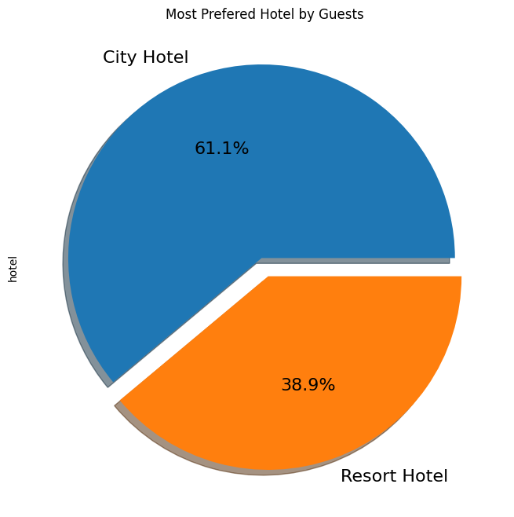
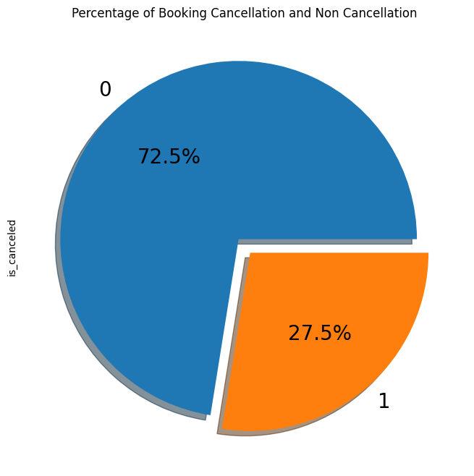
Which hotel has more bookings??
Total Cancellation Percentage
More than 60% bookings are for City Hotel and rest for Resort Hotel so we can say City Hotel is most preferred by guests.
27.5% bookings were cancelled out of all bookings.

Slide 8
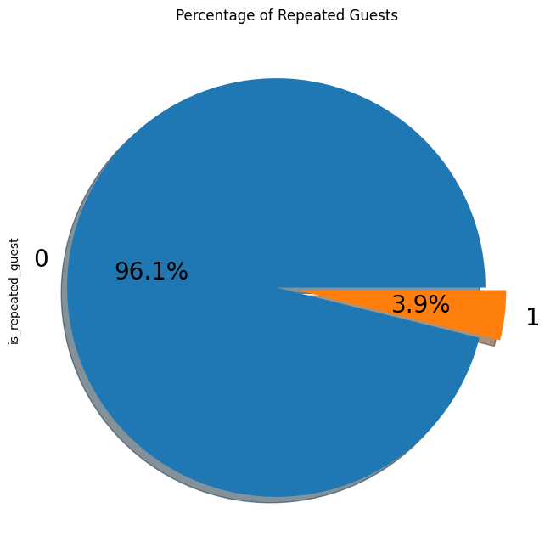
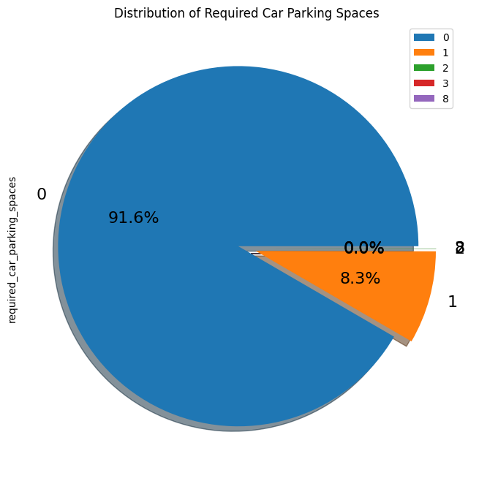
Total Percentage of Repeated Guests
Distribution of Car Parking
Only 3.9 % people were revisited the hotels. Rest 96.1 % were new guests. Thus, retention rate is low.
Most of the customers(91.6%) do not require car parking spaces. Only 8.3 % people required only 1 car parking space.

Slide 9
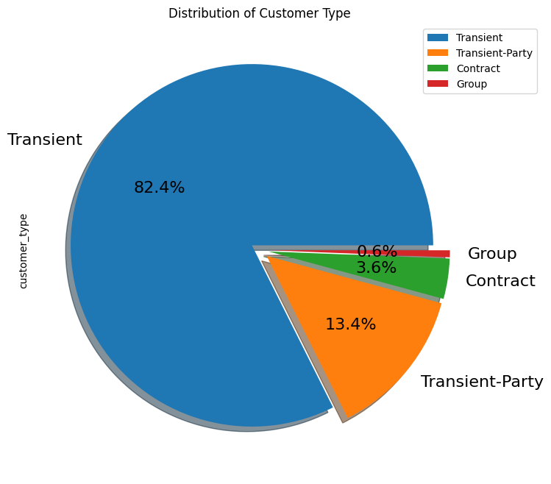
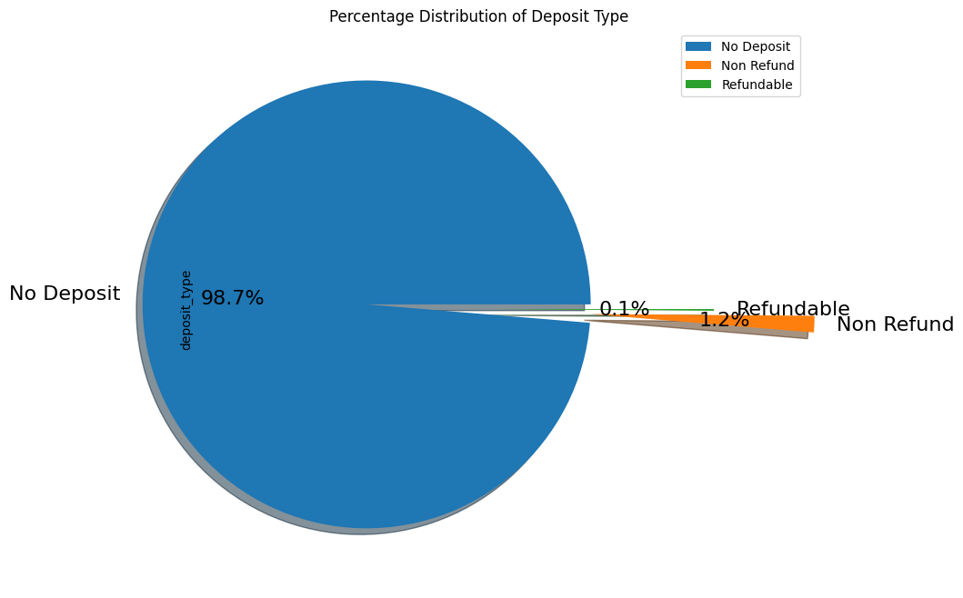
Distribution of Customer Type
Distribution of Deposit Type
Most of the customers/guests were Transient type(82.4%). And transient party were 13.4% and 0.6 belongs to group. Remaining guests belongs to Contract type.
Contract-when the booking has an allotment or other type of contract associated to it
Group -when the booking is associated to a group
Transient-when the booking is not part of a group or contract, and is not associated to other transient booking
Transient-party-when the booking is transient, but is associated to at least other transient booking
Almost 98.7% of the guests prefer ‘No deposit’ type of criterion while booking hotels.

Slide 10
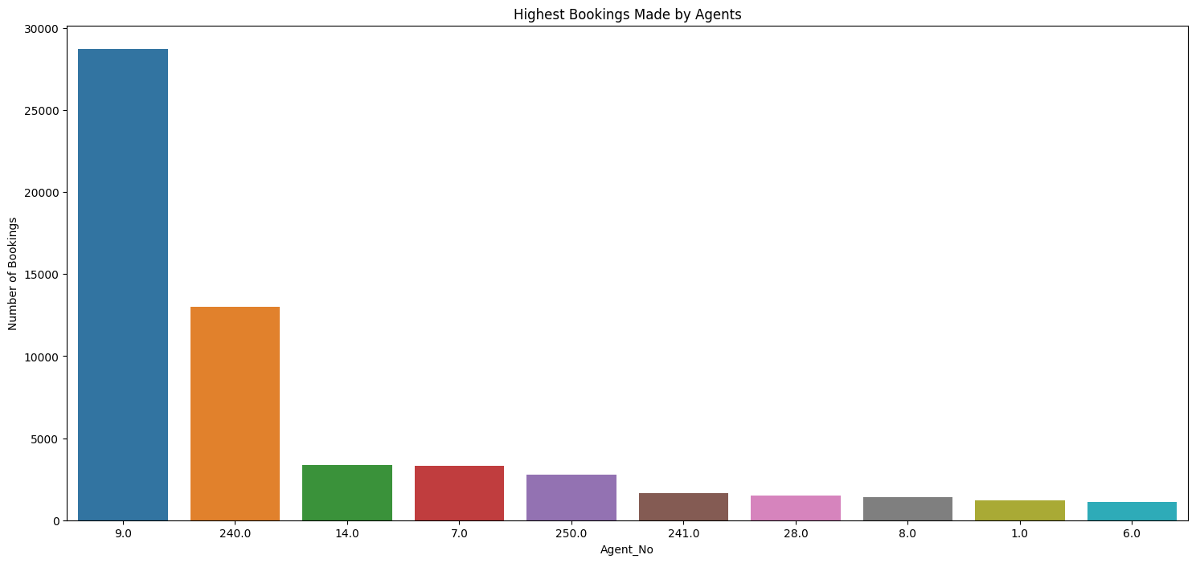
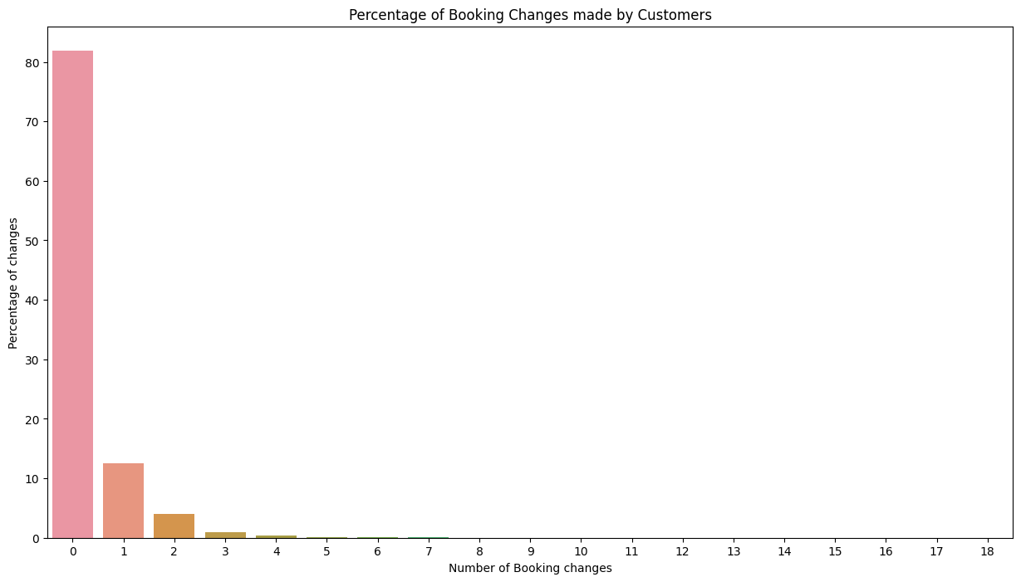
Highest Bookings Made by Agent
Percentage of Booking Changes made by customer
Agent Id: 9 made the highest bookings which is more than 25,000.
Almost 82% of bookings were made 0 changes while around 12% bookings were made 1 changes

Slide 11
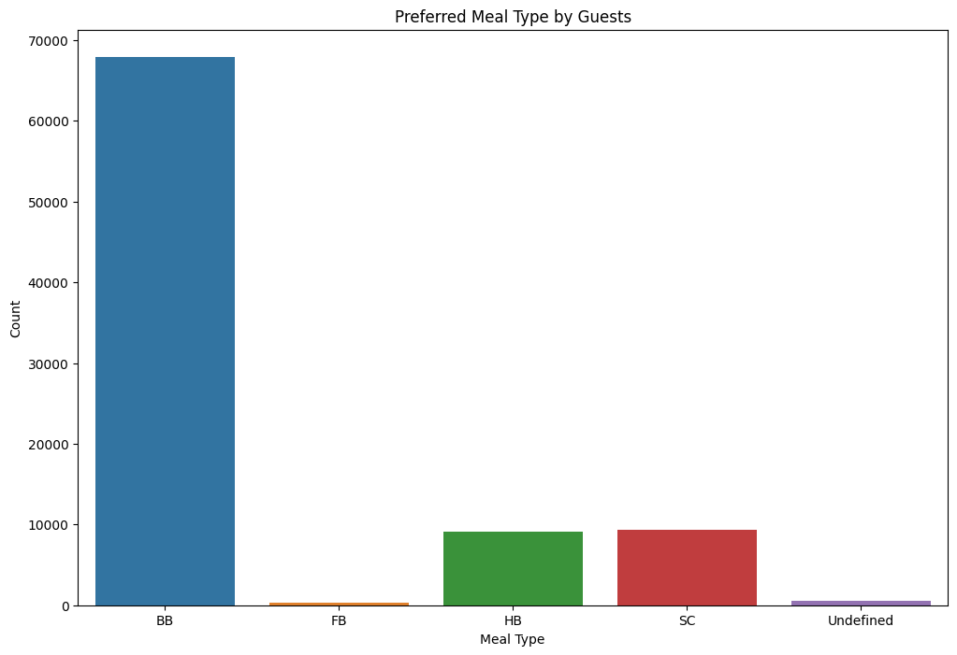
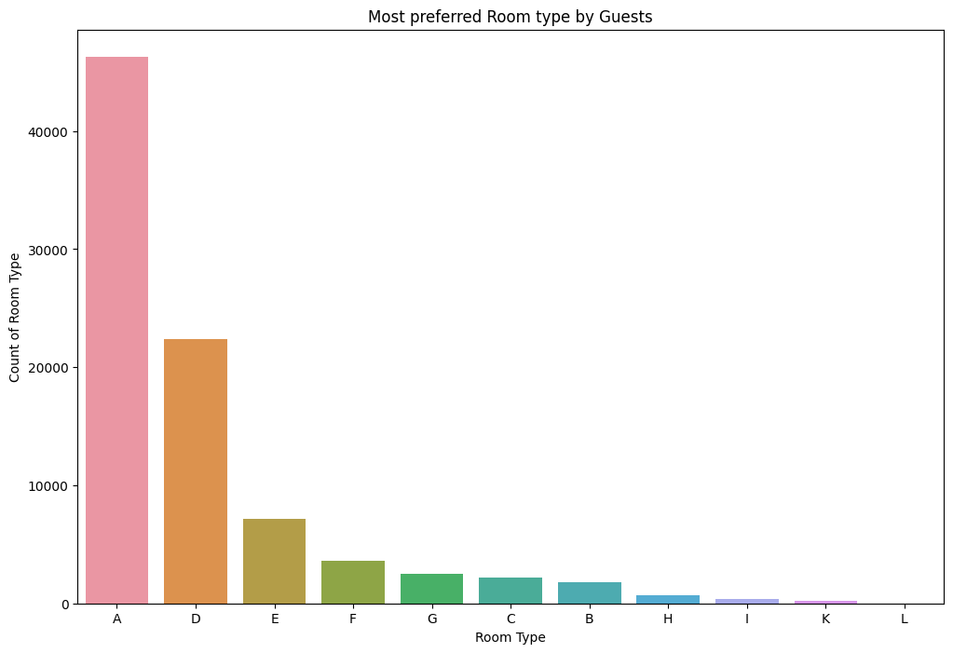
Preferred Meal Type By Guests
Most Preferred Room Type by Guests
Type of meal by the guests:
BB( Bed & Breakfast) is the most preferred
FB (Full Board) is least preferred.
HB (Half Board) and SC(Self Catering) are equally preferred.
Room type ‘A’ is most preferred by the guests second most preferred is ‘D’.

Slide 12
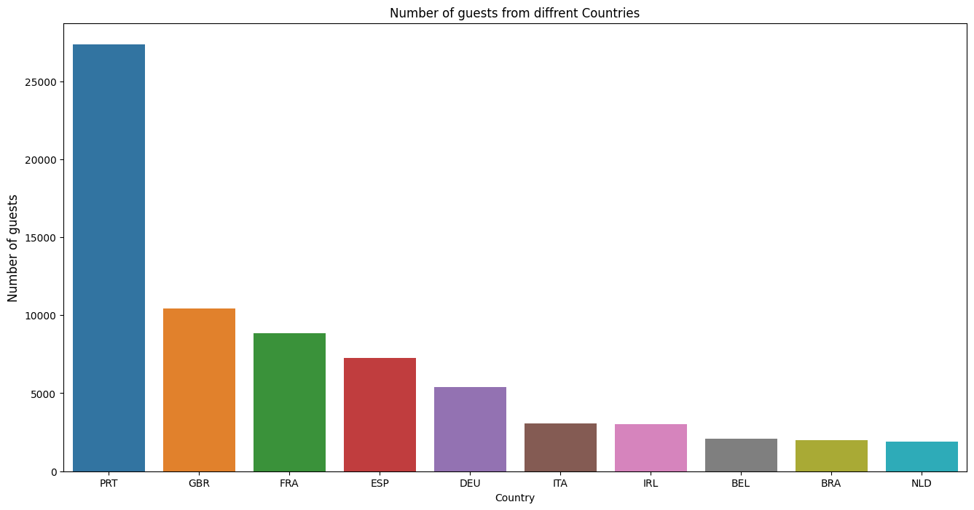
Maximum number of guests were from Portugal.
i.e., more than 25000 guests.
After Portugal, GBR(Great Britain),France and Spain are the countries from where most of the guests came.
PRT- Portugal GBR- United Kingdom FRA- France ESP- Spain DEU - Germany ITA -Italy IRL - Ireland BEL -Belgium BRA -Brazil NLD-Netherlands

Slide 13
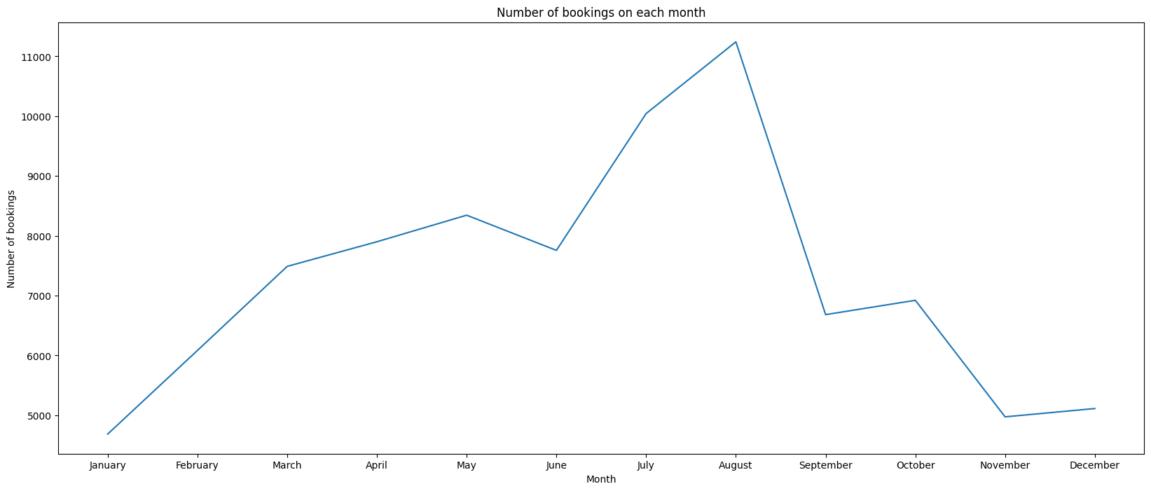
As we can see in the line chart, from June to September most of the bookings happened, as it’s Summertime. After September bookings Starts declining.

Slide 14
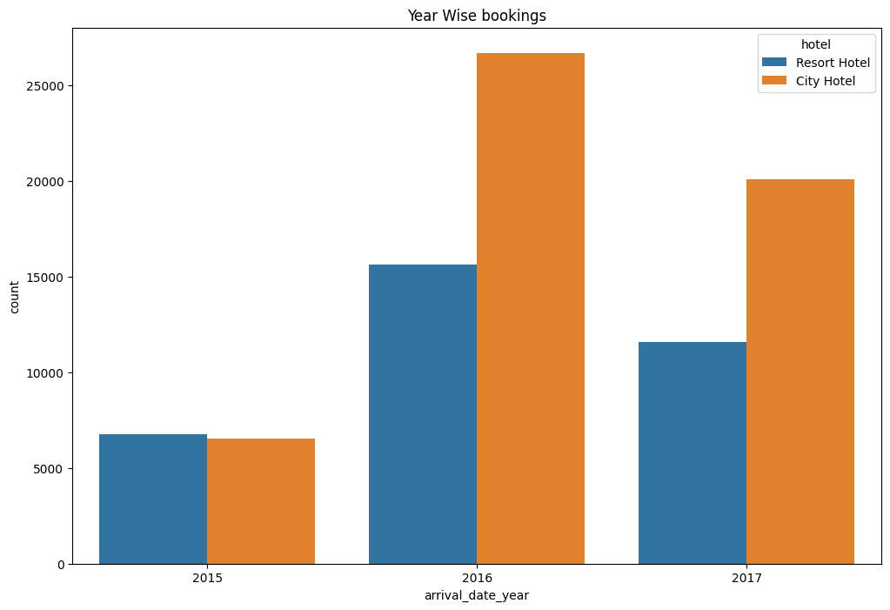
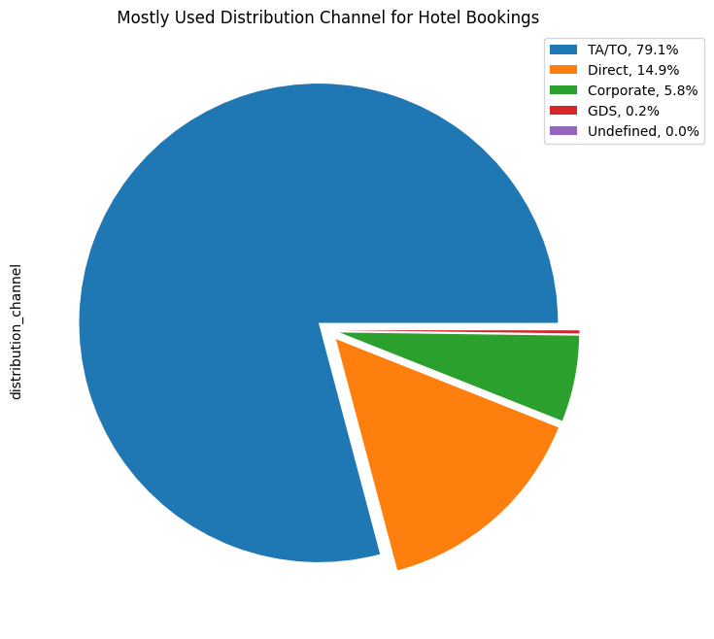
79.1 % bookings were made through TA/TO (travel agents/Tour operators).Second most channel is direct.
Most of the bookings for City hotels and Resort hotel were happened in 2016. As we can see Most of the bookings were for City hotels.

Slide 15
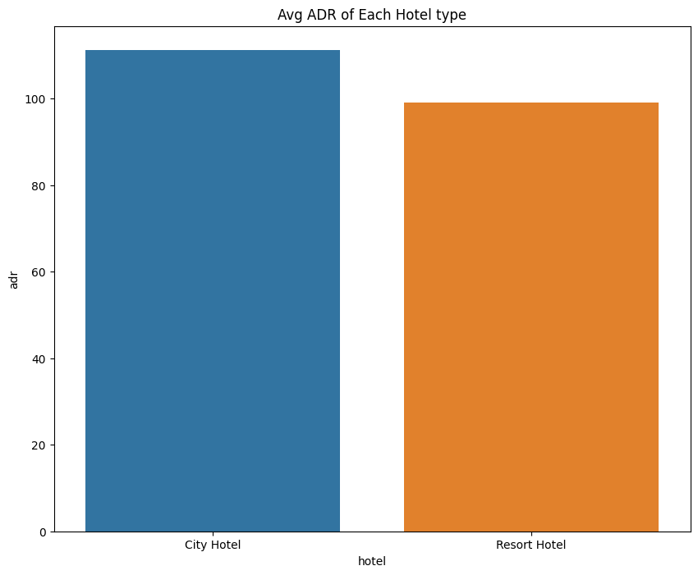
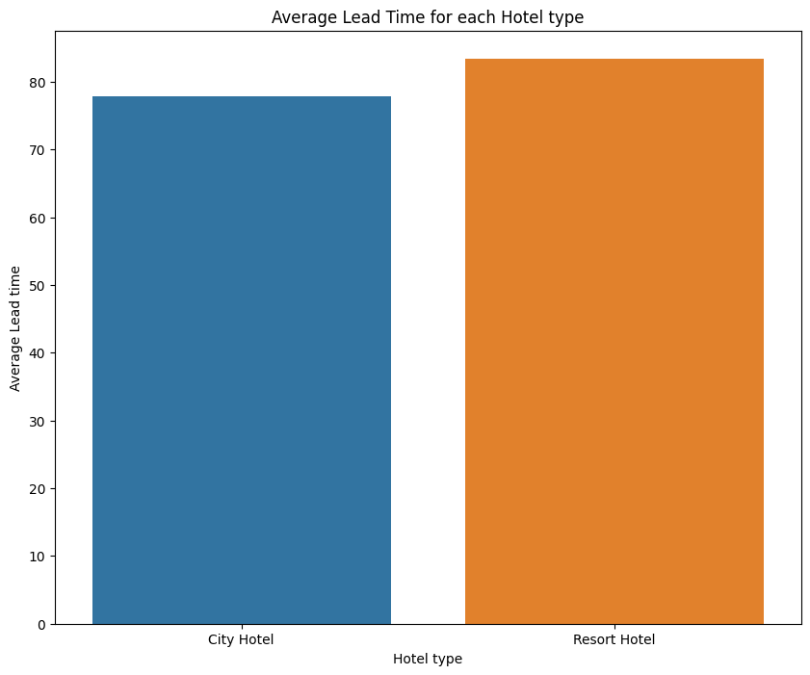
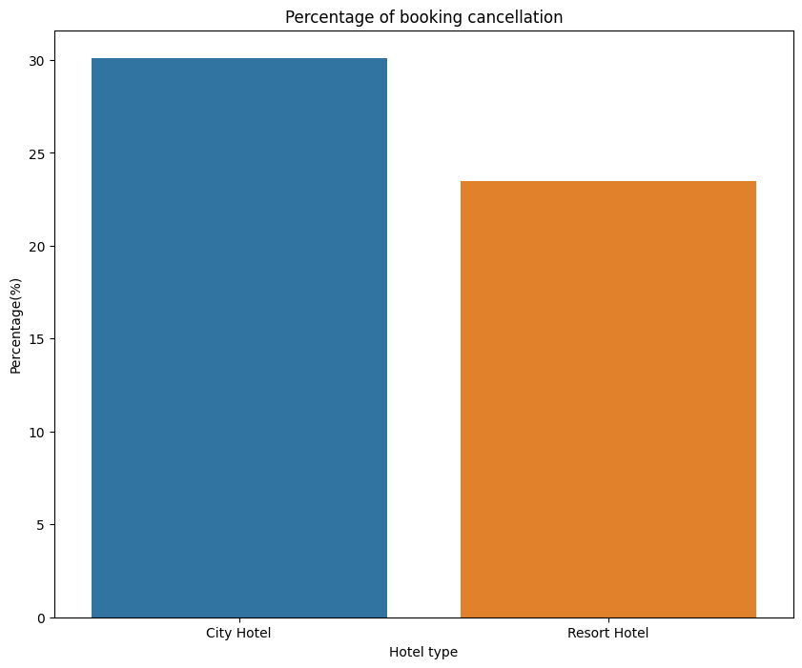
Average ADR of Each Hotel type
Average Lead time for Each Hotel type
Percentage of Booking Cancellation
Average ADR for city hotel is high as compared to resort hotels. These City hotels are generating more revenue than the resort hotels.
Average lead time for resort hotel is high. It means people plan their trip too early. Usually, people prefer resort hotels for longer stays. That’s why people plan early
Booking cancellation rate is high for City hotels which almost 30 %.

Slide 16
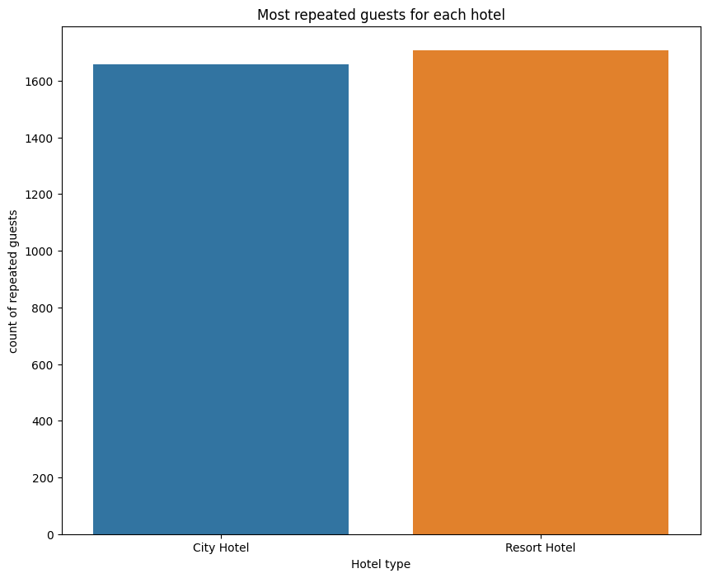
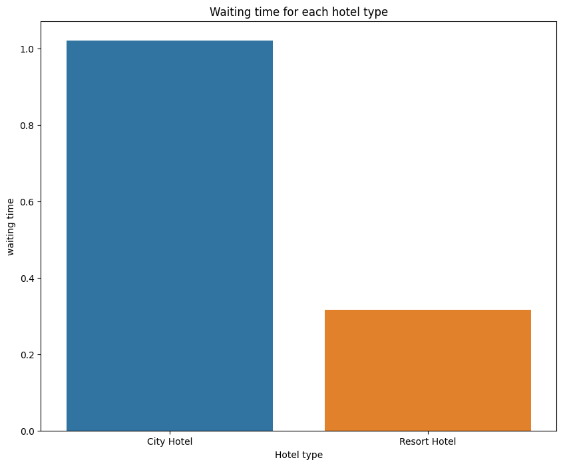
Waiting time period for City hotel is high as compared to resort hotels. That means city hotels are much busier than Resort hotels.
Resort hotels has the most repeated guests. In order to get increase the count of repeated guests hotel management need to take the valuable feedbacks from the guests and try to give good service.

Slide 17
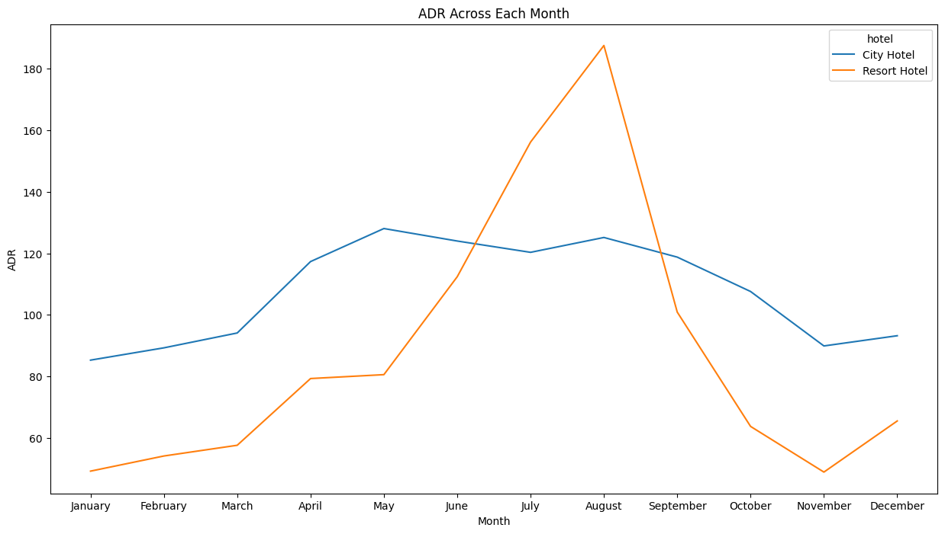
Resort hotels had the highest adr in June ,July and August than the City hotels. But in other months adr of Resort hotel was less than the City hotels.
Thus, we can say that the January, February, March, April ,November and December are the good months for customers as the average daily rate in this months are very low.

Slide 18
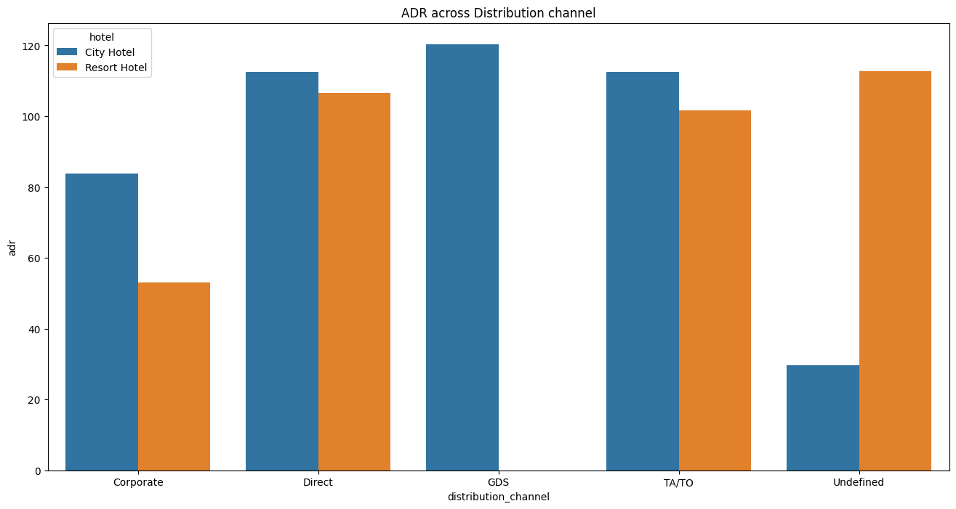
Corporate: These are corporate hotel booing companies which makes bookings possible.
GDS: A GDS is a worldwide conduit between travel bookers and suppliers, such as hotels and other accommodation providers. It communicates live product, price and availability data to travel agents and online booking engines and allows for automated transactions.
Direct: means that bookings are directly made with the respective hotels
TA/TO: means that booings are made through travel agents or travel operators.
Undefined: Bookings are undefined. may be customers made their bookings on arrival.
From the plot is clear that, 'Direct' and 'TA/TO' has almost equally contributed in adr in both type of hotels i.e., 'City Hotel' and 'Resort Hotel'. GDS has highly contributed in adr in 'City Hotel' type. GDS needs to increase Resort Hotel bookings.

Slide 19
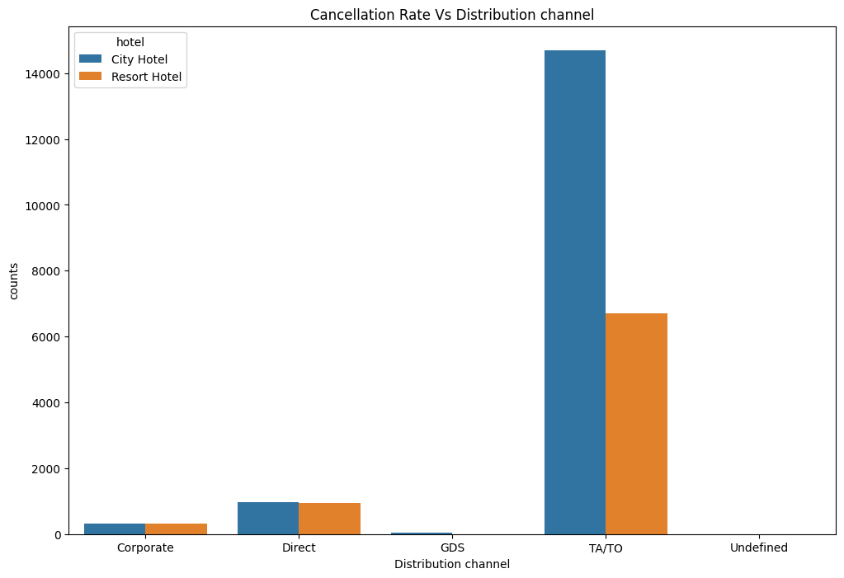
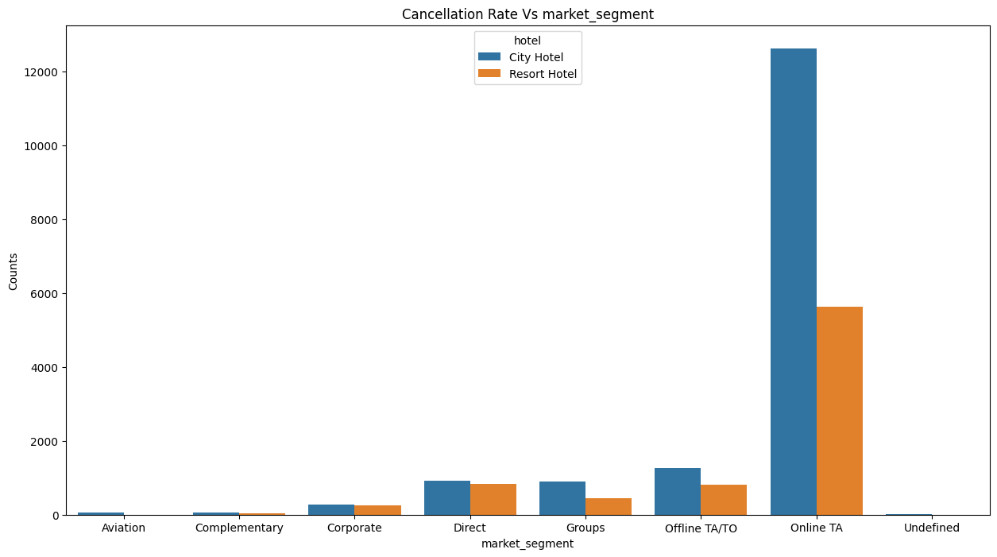
Distribution channel:
‘TA/TO’ distribution channel has highest cancellations for city hotels and more than 6000 cancellations for resort hotels. In order to reduce the cancellations, they should improve their cancellation policies and deposit policies.
Market Segment:
‘Online TA/TO’ market segment has highest cancellations for city hotels.

Slide 20
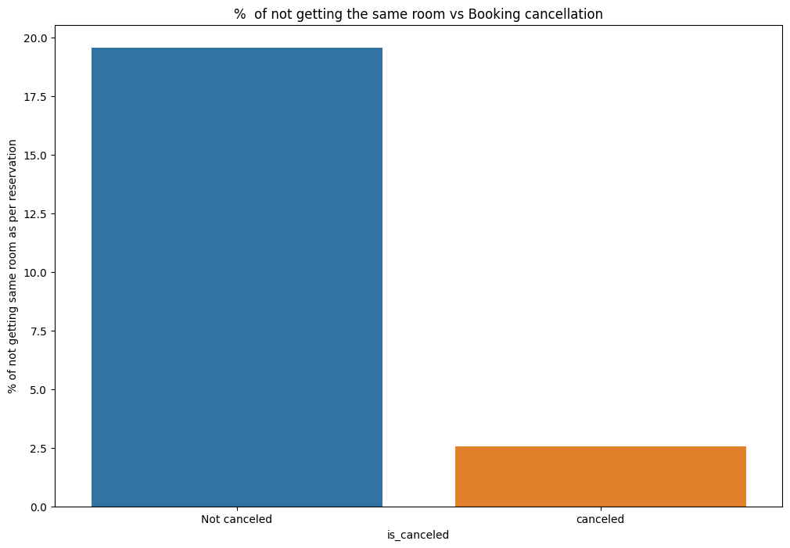
Online T/A' has the highest cancellation in both type of cities In order to reduce the booking cancellations hotels need to set the refundable/ no refundable and deposit policies.
Its is clear that there is no much(2.5%) effect on cancellation of the bookings even if the guests are not assigned with rooms which they reserved during booking.

Slide 21
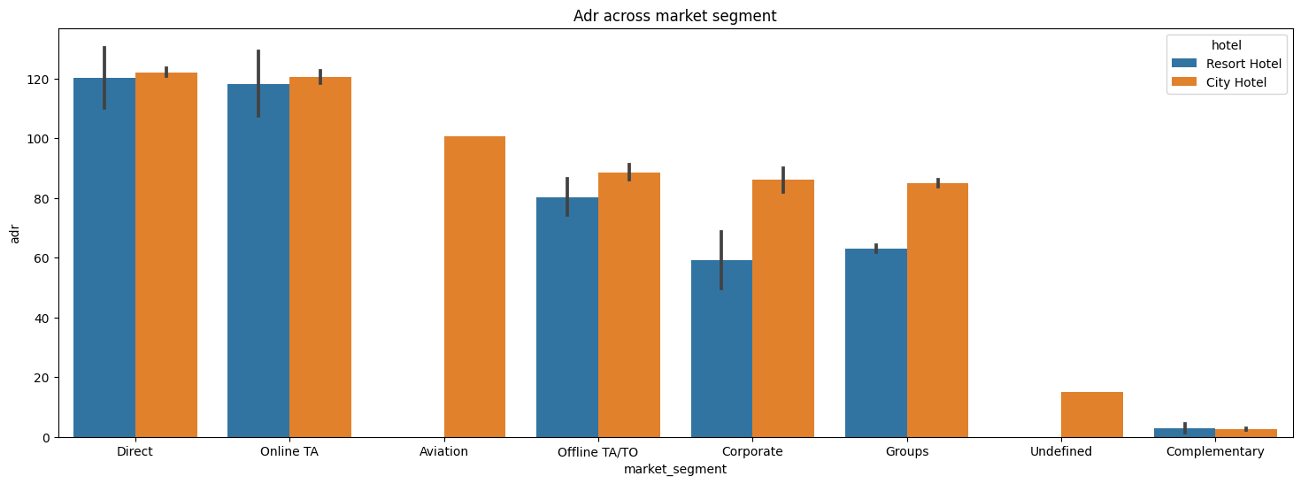
Here “Direct” and ‘Online Travel Agency’ has high adr for both hotel types. Aviation segment needs to increase Resort hotel bookings.

Slide 22
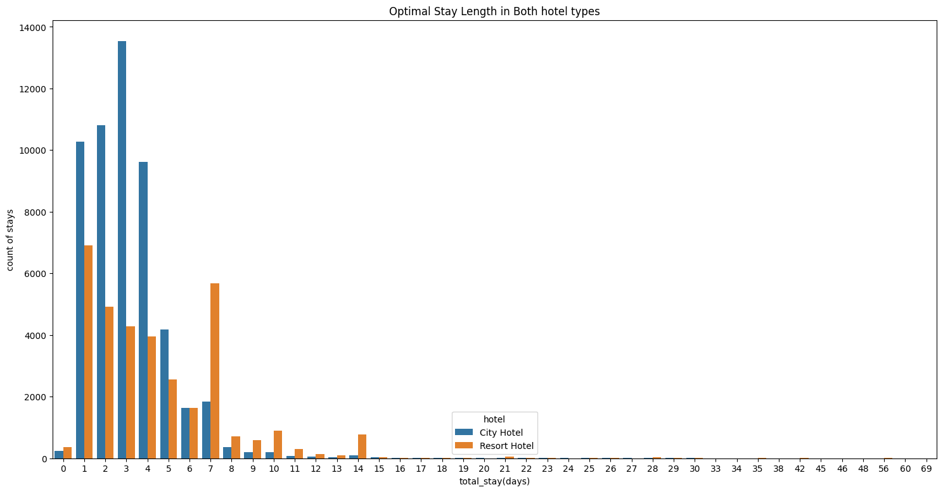
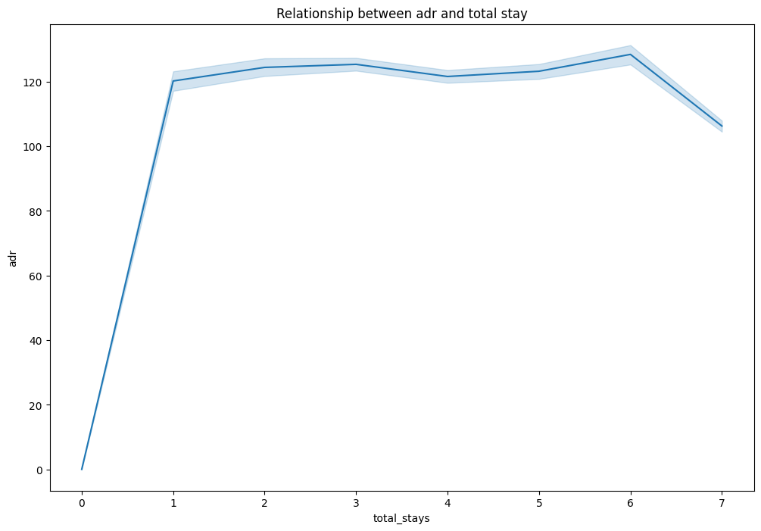
Optimal stay Length in Both Hotel Types
Relationship Between ADR and Total Stay
Optimal stay in both the type hotel is less than 7 days.
For more than 7 days, people likes to stay in Resort hotels.
Here, As the total stay increases the adr also increases.

Slide 23
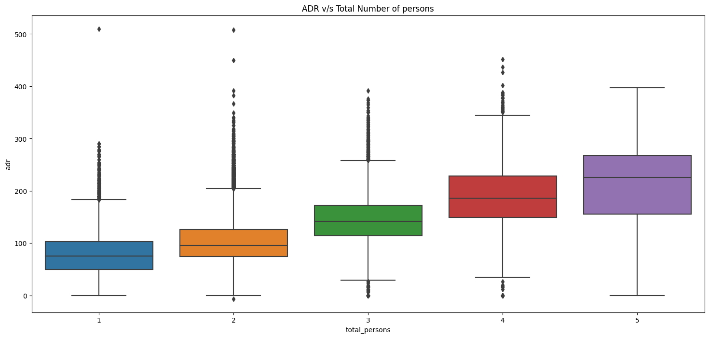
As the total number of people increases adr also increases. Thus, adr and total people are directly proportional to each other.

Slide 24
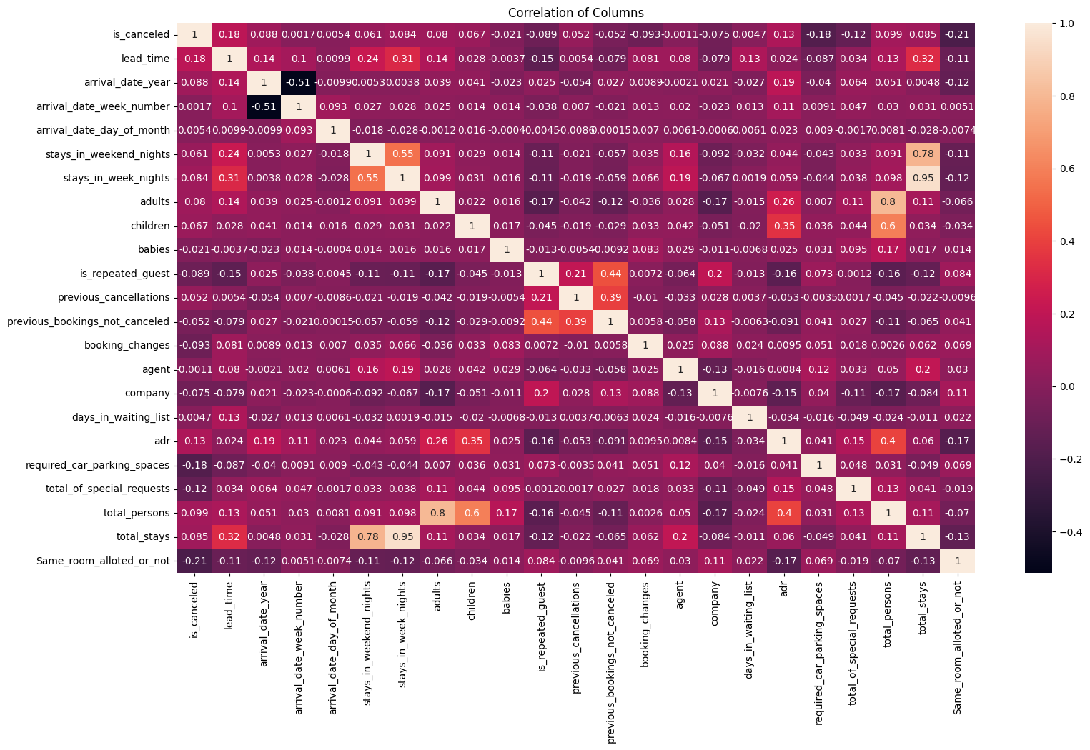
is_canceled and same_room_alloted_or_not are negatively corelated. That means customer is unlikely to cancel his bookings if he don't get the same room as per reserved room.
lead_time and total_stay is positively corelated, that means more is the stay of cutsomer more will be the lead time.
adults,childrens and babies are corelated to each other. That means more the people more will be adr.
is_repeated guest and previous bookings not canceled has strong correlation. may be repeated guests are not more likely to cancel their bookings.

Slide 25
Suggestions to Achieve Business Objective
The Booking patterns consistently peak in July and August, increase staffing and inventory during these months to accommodate the increased demand.
Optimize pricing and availability of room types based on customer preferences. Since room type A is the most preferred, ensure that it is available during peak booking months and adjust pricing accordingly
Increase customer satisfaction by improving the online booking process and customer support.
Since breakfast in bed is the most popular meal, consider offering it more often or as a package deal to increase revenue and customer satisfaction.
Negative correlation between ADR and stay duration suggests that customers staying for shorter periods generate more ADR. This information can inform the company to focus on attracting more of these customers to increase revenue.
The information on the average stay duration being relatively higher for the months June to September can help the hotel management to better allocate resources to meet customer needs during these periods.
To reduce the cancellation rates, the management could encourage customers who are making a deposit by providing additional offers and reduced rates.
The hotel should direct its marketing efforts towards online mediums to capture more bookings.

Slide 26
Conclusion
In summary, the hotel booking data can be used to gain insights into booking patterns and customer behavior, which can inform strategies for increasing occupancy, revenue, and customer satisfaction.
The hotel should focus on increasing staffing and inventory during peak booking months, improve pricing strategy, improve customer support, offer popular amenities and services as add-ones during booking, build relationships with online travel agents, encourage deposits during booking also direct marketing towards online and social media.
By implementing these strategies, the hotel management will be able to achieve their business objectives.

